Slide 1
Who am I? Who are you?
Who are we?

Slide 2
How can we work together to create an open, supportive, and reflective learning community?
Notes:
Hi I’m Mrs. Rouse. I’m not going to introduce myself fully right now, but you may have seen my flipgrid introduction. I will share some more in a minute, but now I want us all to have a turn to share about about ourselves.

Slide 3
Getting to know each other
Day 1

Slide 4
“I write because I don’t know what I think until I read what I say.”
—Flannery O’Connor
Notes:
This week I want us to get to know each other and build community. We going to begin with journaling. I have created a journal for you in Google Classroom to use this week. I would like journaling to become a habit we practice this year. We are living through some pretty monumental events right now, from coronavirus to the latest chapter in the Black struggle for equality in this nation, not mention that this is going to be an election year. There is a lot to process and unpack this year. Journaling is about slowing ourselves down to become aware of our own thoughts.

Slide 5
Journaling
1
2
3
Why journal?
Who is it for?
How to write?
Reflecting on your thoughts and feelings about what we are learning.
A place for us to interact in a safe space.
Informal writing that helps you express yourself
Notes:
Why are we journaling? Unlike math and science, in ELA and Social Studies we are thinking about ourselves and our world in ways that can raise challenging ideas and emotions. Journaling is about reflecting on those thoughts and feelings as we learn and reflect on the world. This not a blog that you are writing for all to read. It is for you. Neither is it a diary for your private thoughts. I am planning on reading your journal at times. I need to make clear to you that I (and all teachers) are required by law to inform officials if we become aware of information that could possibly harm you or another student.
Who is the journal for then? It is a space for you as individuals and me to interact in a safe place. I will not share anything from your journal. If you want to share reflections from your journal for discussions or assignments, you are welcome to do that.
So, how should I express my thoughts? Your journal is not about right or wrong answers. It is not about writing in perfect grammar or spelling. It is about expressing yourself. If you find it easier to express your thoughts by talking, use the speech-to-text function. You can write in you mother tongue if that is most natural for you and I will try to use google translate to get a sense of what you are saying. If you would prefer to draw your ideas, you may do that as well. If you are drawing on paper at home, please put a picture of your reflection in your journal. Your journal is not for a grade. It is a workspace for you to process and build your thoughts.

Slide 6
My Name
I was given my name because
I like / I dislike my name because
My name is / isn’t a good fit for my personality because
People assume ______ about me because of my name
Notes:
Why don’t you open your journal, if you haven’t already. In the journal, I have given you some writing prompts on page 2, as pictured here. Take about 5 minutes to complete the sentence starters. https://timer.onlineclock.net/

Slide 7
Lisa Anne Kelly-Rouse
I was given my name because my parents liked the sound of it. My brother was named after my father, but as far as I know, my sister and I had no special meaning. I did look up my name and several years before and many years after I was born, it was one of the most popular girls names.
I dislike my name because of its popularity. I was always one of 3 Lisas in my class, and I always had to be “Lisa K”. I also disliked not being able to have a nickname. I had a friend try to help out and called me Li-Li...but I really didn’t like that.
My name isn’t a good fit for my personality because I like to be different and having a common name, without a special reason, made me feel ordinary.
People may assume how old I am because of my name. I don’t know that you would assume anything special about me. You don’t hear my name much any more, so I guess, if anything, you may assume I was born in the 60’s or 70’s.
Notes:
We are going to break out into small so you can get to know some of your classmates. Before we do that, let me share with you how I journaled my own name.

Slide 8
Break-Out Groups
Notes:
We are going to break out into small groups for about 10 minutes, so you can get to know some of your classmates.
https://timer.onlineclock.net/
I am dropping a link in the chat. It will open a document with your small group and a google meet link. (Present the document.) You do not need to leave this Meet session, but you should make sure you mic is muted. You should click on the link for your group to open another Google Meet Session. I’m going to ask the first person whose name is listed first in each group to act as our time keeper. We should come back in 10 minutes.
When you are all there, each person should take about a couple minutes each to introduce yourselves. Share as you are comfortable. When you are done you should thank each other for sharing and return to our main class. You should hear the timer go off when the ten minutes are up.
CORE 1:https://docs.google.com/document/d/1GvVC9ujdCDUFOOddS001NEdVqBzq8zsg7WjJt4FqV8k/edit#heading=h.p2ah1dvtov0m
Core 2: https://docs.google.com/document/d/11ZWb5f1T0M8IUtTDhg7NsJsQv_tb3sWLbofD5otIc1o/edit#heading=h.p2ah1dvtov0m
Core 3: https://docs.google.com/document/d/1OSF87qdQsl2-J7bZaoiId1i6q5Z6ifpN70n6xK6SYpI/edit#heading=h.qdr6a3wby3dx
Core 4: https://docs.google.com/document/d/17hSIS2KY2oTH_Fn_qM1qTHCu3eAo3gb1T-KRIHfOPIw/edit#heading=h.qdr6a3wby3dx

Slide 9
Exit Ticket
What do you need?
https://forms.gle/gb7ZgnMaTzA3BDLr9
Notes:
https://forms.gle/gb7ZgnMaTzA3BDLr9

Slide 10
August 25, 2020
Please go to Google Classroom and Complete Bellringer.
Review assignments page and make sure you’ve completed assignments.

Slide 11
Who am I?
Day 2

Slide 12
“It is through our names that we first place ourselves in the world.
Our names, being the gift of others, must be made our own.”
Ralph Ellison, American Author
Notes:
When we meet someone new, our name is usually the first piece of information about ourselves that we share
Yesterday we talked about our names and what they represent. But today we will think about how if names are a way to reflect who we are, what else reflects that?

Slide 13
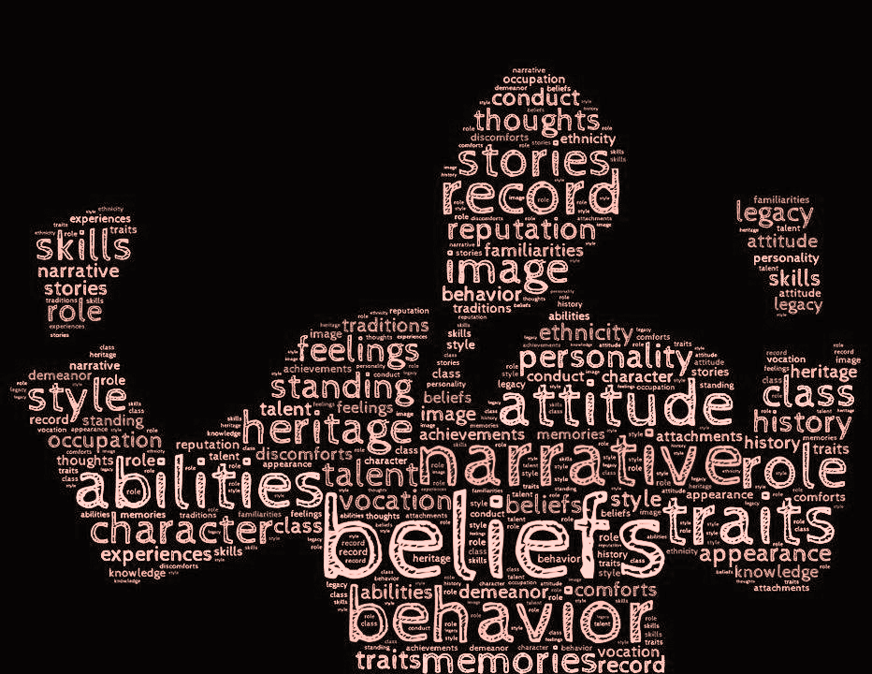
What is Identity?
What are factors that shape who we are?
2. How do
our names relate to our identity?
Notes:
If names are one way we are GIVEN identity, and our Identity is introduced to the rest of the world, HOW ELSE do we become who we are?
What do you do when you want to know who or what someone or something is? Answer: Google It...Think about who you are by imagining wht they would like to see among the results if they were t do a search on their own name

Slide 14
Birth Name | Chosen Name
Shawn Corey Carter | Jay-Z
Stefani Joanne Angelina Germanotta | Lady GaGa
Eric Marlon Bishop | Jamie Foxx
Mark Vincent | Vin Diesel
Onika Tanya Maraj | Nicki Minaj
Peter Gene Bayot Hernandez | Bruno Mars
Cassius Clay | Muhammad Ali
Theodor Geisel | Dr. Seuss
Richard Lewis Smith | Richard Lewis Barnett
Jeff Davis | Thomas Grant
Notes:
Do you recognize names from this list? Why did those individuals
On the right is the names they were given, and the right, the names they took. Does your own name reflect who you are...
Richard(Dick) Lewis Smith and Jeff Davis were slaves, freed after the Civil War

Slide 15
Padlet Questions for Discussion
What reasons might people have for changing their names?
Do any of these name changes surprise you? Why?
Most of the people on this list are celebrities. Why do you think these people might have changed their names as they became more recognizable? What image might they have trying to convey?
The last two names on the list are of people who were emancipated from slavery after the Civil War. Why might they have chosen to change their names?
How are names related to our personal histories? How might they be related to our national history?
Are names the same as who we are? How much of you changes when your name changes?
Notes:
You will respond to these questions on padlet- You will answer a minimum of 3 and respond to 2 or more.

Slide 16
“Two Names, Two Worlds”
https://drive.google.com/file/d/1-YvXRZDQAEkZ1GBH8Nco08ntM9EU3006/view?usp=sharing
Notes:
https://drive.google.com/drive/recent
https://docs.google.com/forms/d/1ZFOLfuqNVhkL10ZUc44vbv9WXl2wInPi0rNsG3AKt7U/edit

Slide 17
Please
Complete exit ticket and complete any assignments not finished in class, independently.

Slide 18
Exit Ticket
https://docs.google.com/forms/d/e/1FAIpQLScTQY1lmvOeY2ZifEzNcOk5QDWJ0o98n7Z4193vqQcv9m0Kew/viewform?usp=sf_link
Notes:
https://docs.google.com/forms/d/e/1FAIpQLScTQY1lmvOeY2ZifEzNcOk5QDWJ0o98n7Z4193vqQcv9m0Kew/viewform?usp=sf_link

Slide 19
What is community?
Day 3

Slide 20
What is community?
 | Strongly Agree | Agree | Disagree | Strongly disagree
Communities are made up of people who are more or less the same.
Joining a community means you have to give up some of your individual identity.
Communities have certain rules for membership. Not just anyone can belong.
For a community to be strong, all members must like each other.
A history class is a kind of community.
The United States is a kind of community.
Notes:
If the virtual room is working use the four corners
If it isn’t working try Option 2: Google Form and show survey results
https://docs.google.com/forms/d/e/1FAIpQLScxhau-WAeTpENO-s39fmqWXKaZW-1NIqoJYAIWe6oLSypcRg/viewform?usp=sf_link
Invite studentss to share their thoughts on where they are by having them say “me” in the chat function.

Slide 21
Community
“Communities are not built of friends, or of groups with similar styles and tastes, or even of people who like and understand each other. They are built of people who feel they are part of something that is bigger than themselves: a shared goal or enterprise, like righting a wrong, or building a road, or raising children, or living honorably, or worshipping a god. To build community requires only the ability to see value in others, to look at them and see a potential partner in one’s enterprise.”
—Suzanne Goldsmith

Slide 22
Exploring Community
Communities are not built of friends, or of groups with similar styles and tastes, or even of people who like and understand each other.
Write a question that this idea raises for you.
Insert an image below that represents this idea about community.
Write the main idea of this sentence in three or four words.

Slide 23
Exit Ticket
My classroom community
Notes:
https://docs.google.com/forms/d/e/1FAIpQLSfxXbZr2DkLnqfy-SUUi0ZBXuE1YCqwLbMKVyH_iVTi9Sl_xg/viewform?usp=sf_link

Slide 24
Friday, August 28
Do BellRinger 5!

Slide 25
FrAme a Special Item

Slide 26
Learning Objective:
Identify an object(s) that holds special meaning and learn about each other by sharing the stories of these special items.

Slide 27
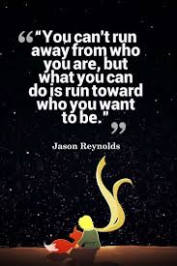

Slide 28
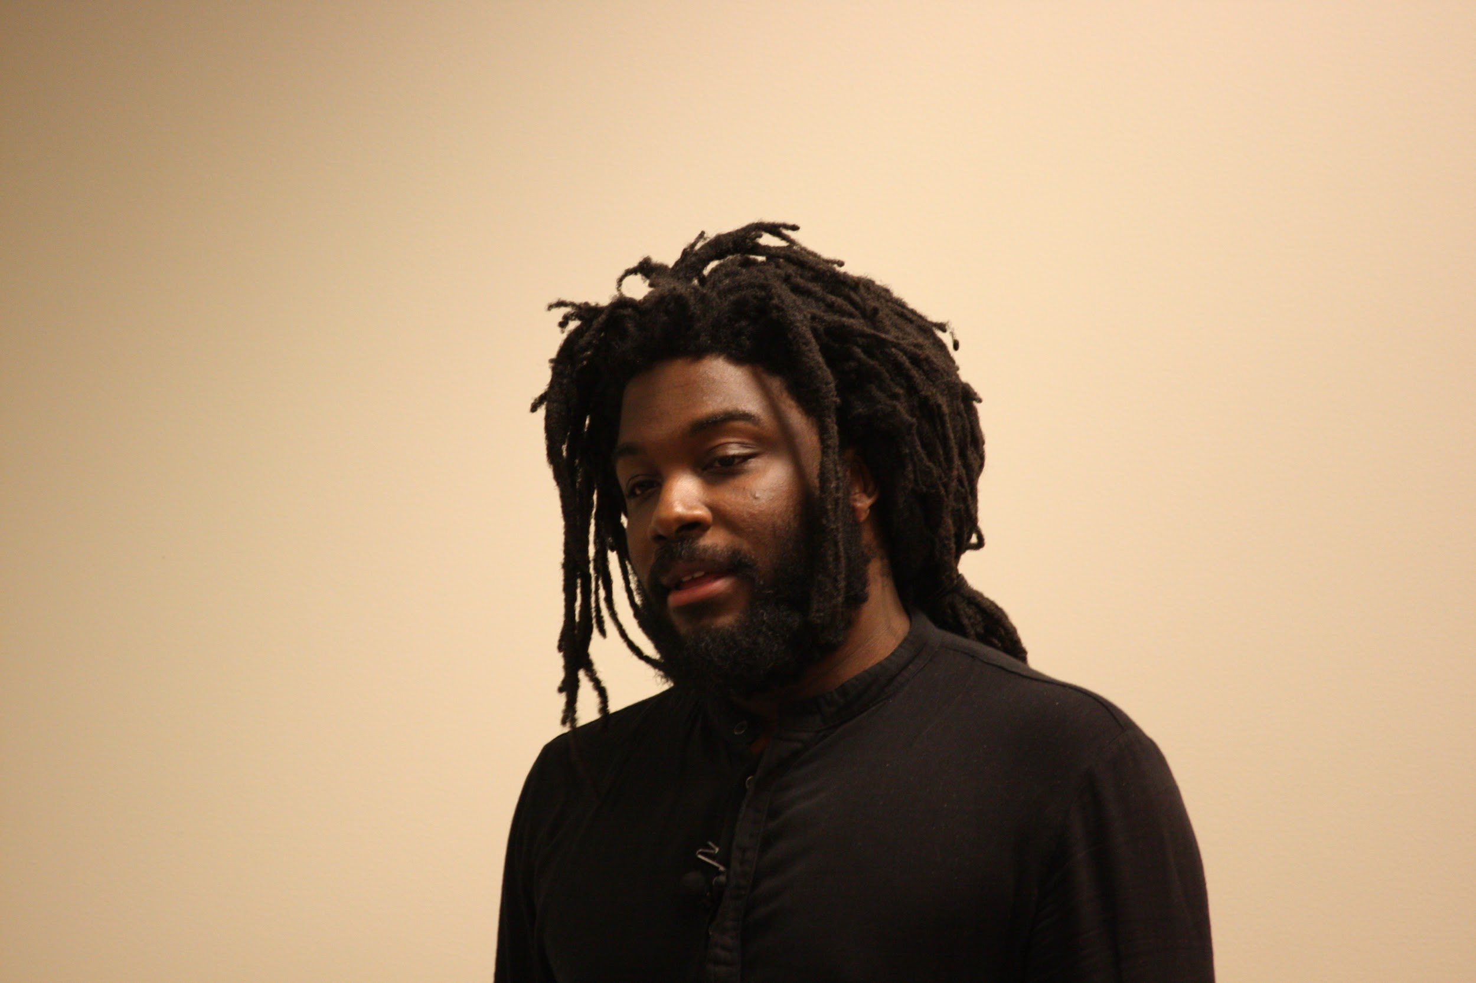
Film, Video Frame a Special Item
Notes:
Film, Video Frame a Special Item
Jason Reynold’s video series Write. Right. Rite author , poet and National Ambassador for Young People’s Literature
Have you ever read anything he’s written?

Slide 29
After the Video
What did you learn about Jason Reynold’s that you didn’t know before?
What kinds of objects does he have framed in his home?
How is framing an object different from saving it in a scrapbook, album, box, drawer, or locker!
What connection does Jason Reynolds make between framing a special item and storytelling?

Slide 30
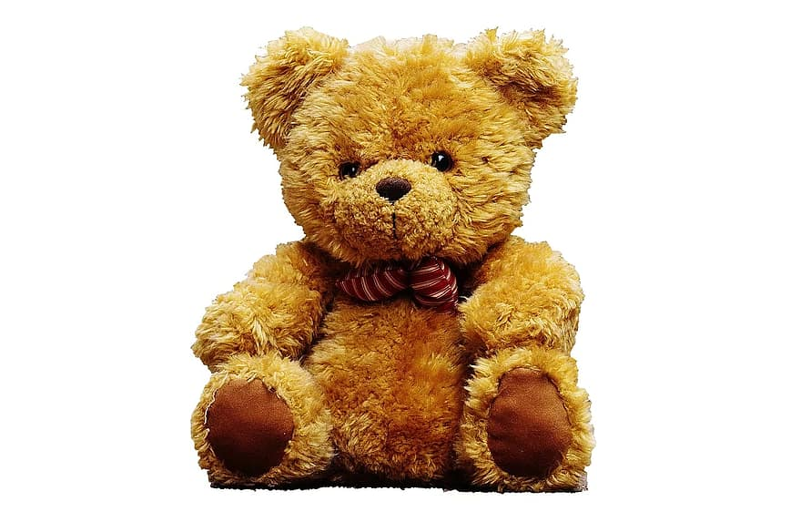
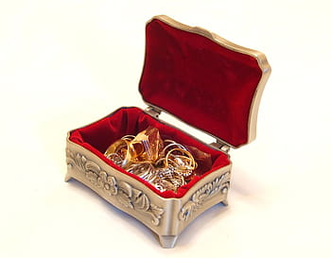
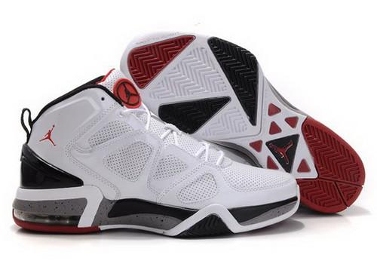
Share a Story of a special item

Slide 31
My Very Special Item
What special Item would you frame?
Where would you hang it?
Why would you frame this particular thing?

Slide 32
Tell The Story: My Dad’s Whistle
My Father passed away a few years ago.
When going through is things, I found his coach’s whistle. It’s a little rusty,doesn’t make sound anymore and it hangs from an old green lanynard. Anyone else may have reached for a watch or ring, but that whistle brings me back to all the time we spent together when he coached football. We’d walk to his practices and talk along the way. It seems like he always had it on. When I see it, I remember him, and that makes it special to me.

Slide 33
Create a google slide with a picture of your special object(or one that looks just like it) and a short story explaining the significance of the item .
Place your screenshot here
Zoom in on a specific moment, such as hitting a “buzzer beater” in a beloved pair of sneakers, or the time a treasured stuffed animal got lost, or the first text you received on your first cell phone. Then tell that story.

Slide 34
Submit your Google SlIde When You are finished. I will compile The Slides And We Can Share them Throughout the Week After OUr Lessons. You may also include a Slide with your Locker, so you can share that too.
The Slides Should Have your Name on Them. These Will Be Due
Monday, August 31.

