Slide 1
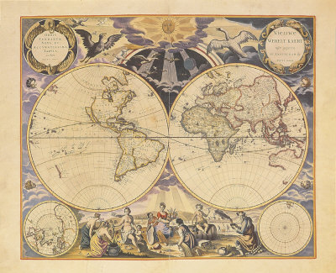
Motivations for
Exploration

Slide 2
CAUSES OF exploration
God
Glory
Gold

Slide 3
THE THREE G’S GOD
Goal: Spread of Christianity
Limit spread of Islam
monopoly on Asian spice trade
Convert native populations
exploit them for land, labor, and resources
Belief that God would reward them
natives would be civilized and cultured

Slide 4
THE THREE G’S .GLORY.
Goal:
Reputation
Recognition
Fame & fortune
Legacy
Amerigo Vespucci → “America”
Christopher Columbus → Columbus Day

Slide 5
THE THREE G’S GOLD
Goal: Increase trade
Asia → home to valuable spices, silk, porcelain, and tea
Huge potential for profits
Competition for control over sea-based trade routes
Northwest Passage: a water route through North America to reach the Pacific → Asia

Slide 6
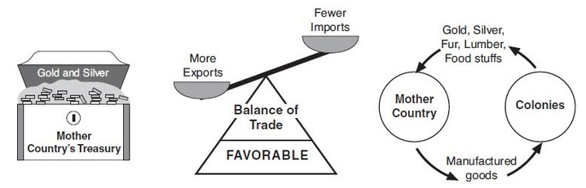
THE THREE G’S GOLD
Mercantilism: a policy that a country’s power depends on its wealth
Wealth came from trade and gold
Created rivalry to establish colonies to send goods back to home country

