Slide 1
September 1, 2020
Do Today’s Bellringer
#7

Slide 2
WHY KNOW THE STORY?
WHAT IS THE STORY?
WHAT IS THE POWER OF THE STORY?
WHAT IS THE OTHER STORY?
The stories we tell about our world shape our identities, beliefs, values and attitudes.
Historians are storytellers, narrating people’s decisions about power, money, their environment, and groups.
HOW DO YOU KNOW THE STORY
The story a historian tells is based on how they make sense of the evidence available from the past.
We are part of the human story and how we understand the past shapes how we live into the future.
All historians have a perspectives and people don’t understand the evidence in the same way.

Slide 3
WHAT IS THE STORY!
7.I.1.3 Analyze details, central ideas, and inferences from sources using discipline-specific strategies.
CONTENT
LITERACY
SOCIAL
I can identify the elements of an historical narrative.
I can visualize a narrative using a chart that identifies the elements of a story
I can collaborate using a common document.
Chronological Thinking Sequence Cause and Effect
Characters Setting Plot Climax Resolution
Collaborate

Slide 4
—UNKNOWN
“The past does not repeat itself, but it rhymes.”

Slide 5
TIMELINE
Event 1
Event 3
Event 5
Event 2
Event 4
Date:
Place:
Description:
Date:
Place:
Description:
Date:
Place:
Description:
Date:
Place:
Description:
Date:
Place:
Description:

Slide 6
Characters
Complication
Climax
Context
Complication
Resolution
Conflict
Complication
Beginning
Middle
End
Who is/are the main character(s),? Why do we care about them?
What is the goal of the main character(s) at the start of Act 2?
What are the stakes?
What was the crisis?
Where and when does the story take place?
How do we learn what type of story it is?
What is the turning point when the character learns something and changes their path?
How is it resolved?
How do the character(s) demonstrate that they learned what they needed?
How is the world disrupted? What is the inciting incident?
What or who is the antagonist?
What is the low point?
What did the character learn by the end of the second act?

Slide 8
TIMELINE
Mother sick
Event 3
Event 5
Family Visits Mother
Event 4
Date: unknown
Place: Hospital
Description: Mother appears to have cancer and is receiving chemotherapy
Date:
Place:
Description:
Date:
Place:
Description:
Date: unknown
Place: hospital
Description: Family after some struggle preparing make it to the hospital
Date:
Place:
Description:

Slide 9
Characters
Complication
Climax
Context
Complication
Resolution
Conflict
Complication
Beginning
Middle
End
A family with with a mother in the hospital and a father who care for their daughter at home.
The father steps in to help his daughter, but also struggles and overwhelmed by the task and time gives her a beanie.
The mother in a wheelchair with her head wrapped receives her family and seeing her daughter decides to remove the scarf.
At home the daughter, Zuri, prepares to visit her mother in the hospital
The father re-commits himself to the styling her hair and following his wife’s instructional video
The family returns home, each having grown in acceptance of their new world with cancer--the daughter’s love for her mothers passion for her natural hair, the father in his new role, and the mother receiving her daughter's love of her as bald.
The daughter Zuri unsuccessfully attempts to prepare her hair following an instructional video made by her mother.
The father patiently and successfully styles Zuri’s hair.

Slide 10
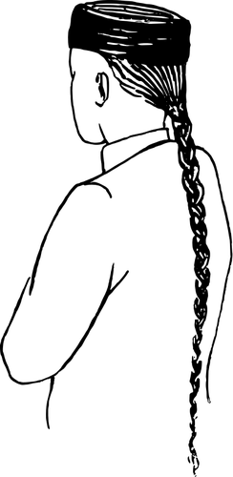
QUEUE ORDINANCE
A queue was a braid of hair that was customary for Chinese to wear during the Qing Dynasty. Cutting it was seen as an act of disgrace.

