Slide 1
September 4, 2020
Do Today’s Bellringer
#10

Slide 2
WHY KNOW THE STORY?
WHAT IS THE STORY?
WHAT IS THE POWER OF THE STORY?
WHAT IS THE OTHER STORY?
The stories we tell about our world shape our identities, beliefs, values and attitudes.
Historians are storytellers, narrating people’s decisions about power, money, their environment, and groups.
HOW DO YOU KNOW THE STORY
The story a historian tells is based on how they make sense of the evidence available from the past.
We are part of the human story and how we understand the past shapes how we live into the future.
All historians have a perspectives and people don’t understand the evidence in the same way.

Slide 3
—MAYA ANGELOU
“History, despite its wrenching pain,
Cannot be unlived, but if faced
With courage, need not be lived again."

Slide 4
WHAT IS THE POWER OF THE STORY!
7.I.1.11 Use a range of civic approaches to address problems being investigated.
CONTENT
LITERACY
SOCIAL
I can identify a community issue.
I can communicate a plan of action to solve a problem
I can collaborate with peers to develop a plan.
Historical Comprehension Historical Context Historical Argument Civic Action

Slide 5
—MAYA ANGELOU
“History, despite its wrenching pain,
Cannot be unlived, but if faced
With courage, need not be lived again."

Slide 6
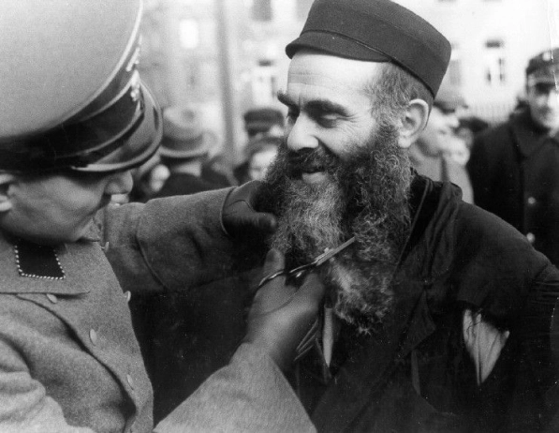
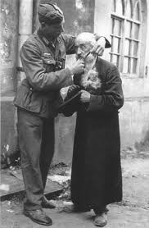
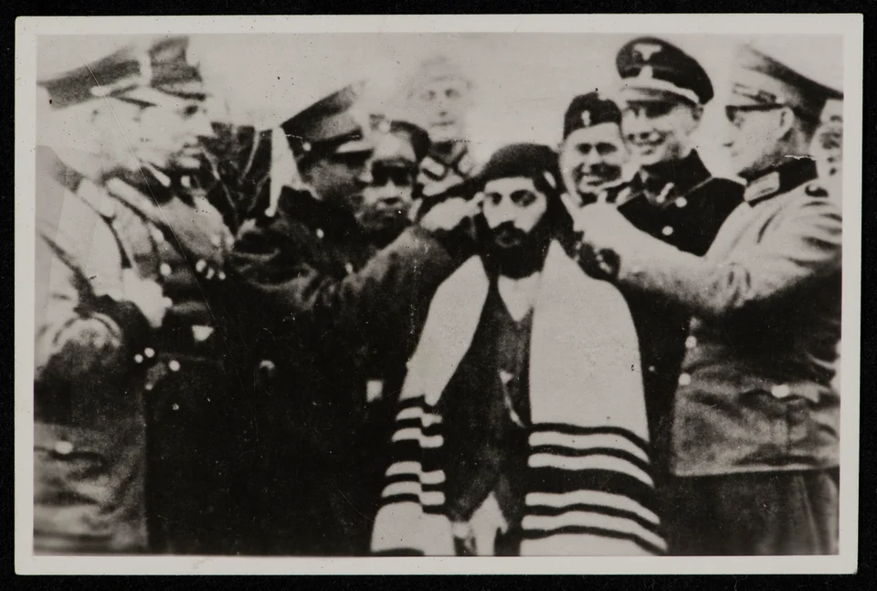
The Wehrmacht Holocaust Role: Humiliation Sport
The Whermacht sport of humiliating Jews along with killing actions operations began from the day the Panzers crashed across the Polish border. Much of the worst (but not all) of the killing operations were conducted by the SS, still a relatively small force. But in every Polish town the Wehrmacht passed through, large numbers of Wehrmacht soldiers amused themselves with humiliating Jews in every way they could imagine. Jews were rounded up and forced to clear the rubble and debris caused by the Germans. They had to hand over their valuables. Some had to entertain their German captors by being forced to dance, sing or doing strenuous exercises. Many devout men had their beards or hair cut off. Here is just one of countless such actions (figure 1).

Slide 7
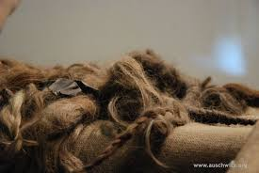
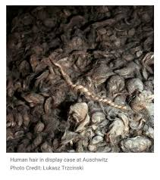
“There is nothing that speaks louder against the Nazi crimes than this hair…. On the transport that I came on, all the women and children were taken from the train and immediately gassed. The hair, along with the combs and suitcases and shoes, is all that remains of them. No matter how painful it may be to look at, it is all part of the story that I believe has to be told.” —Ernest Michel

Slide 8
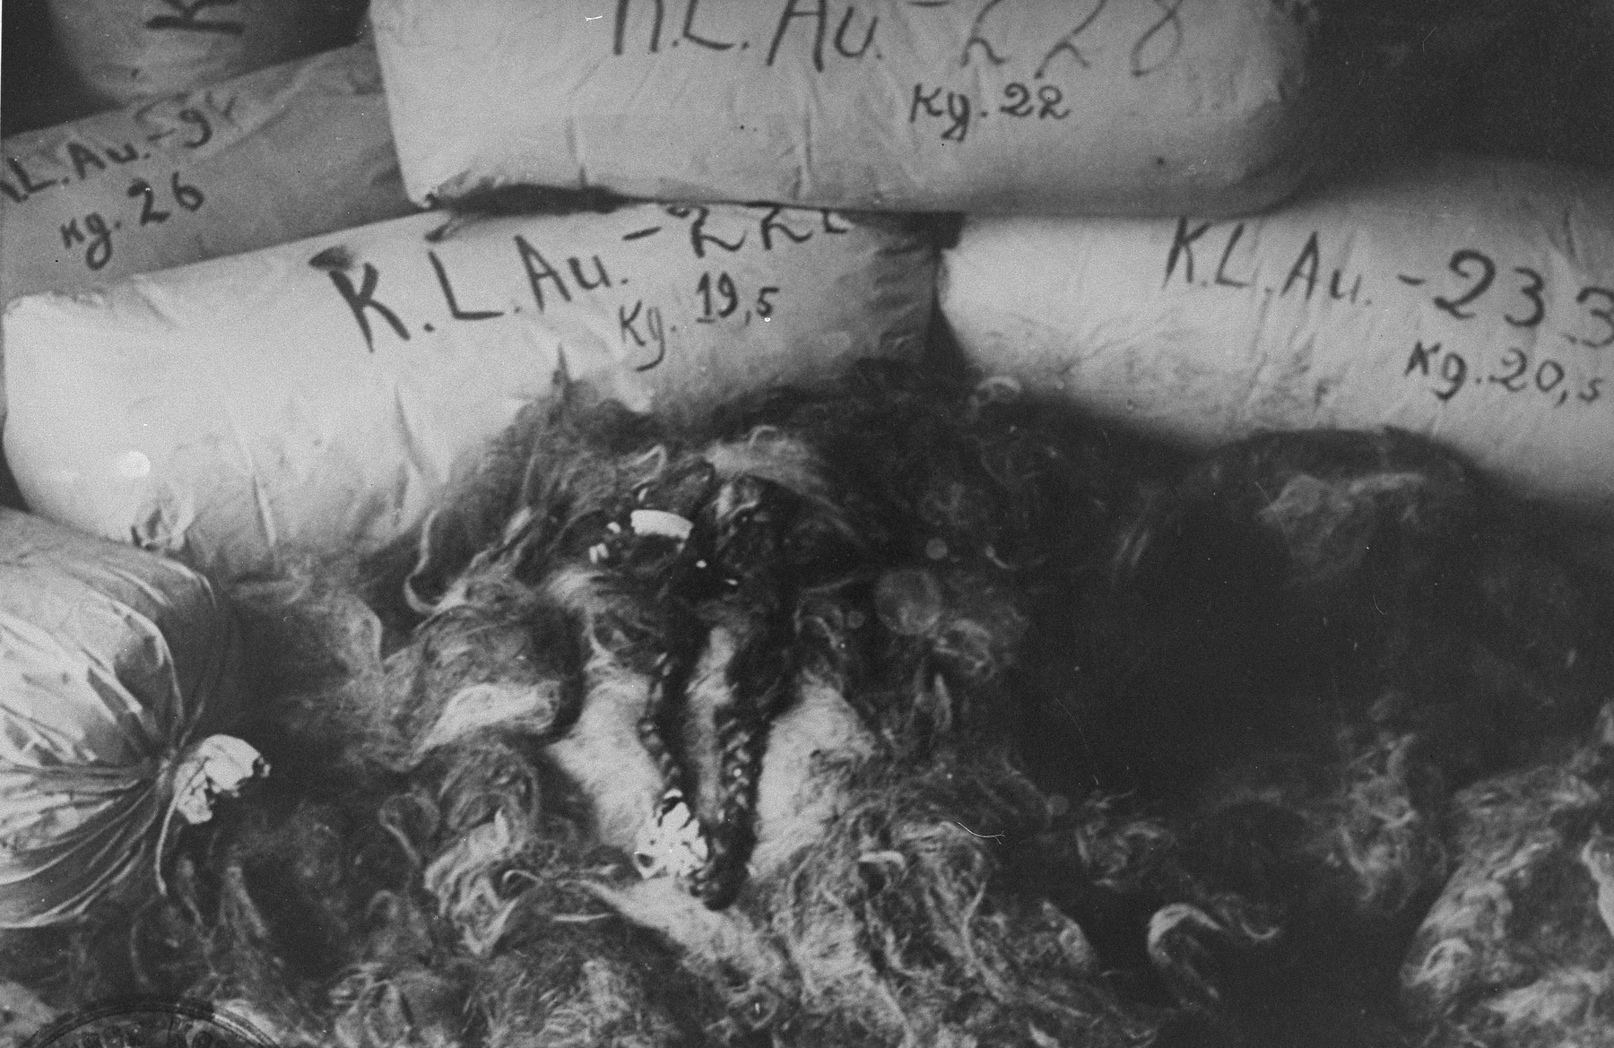
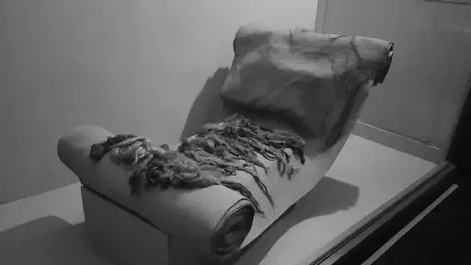
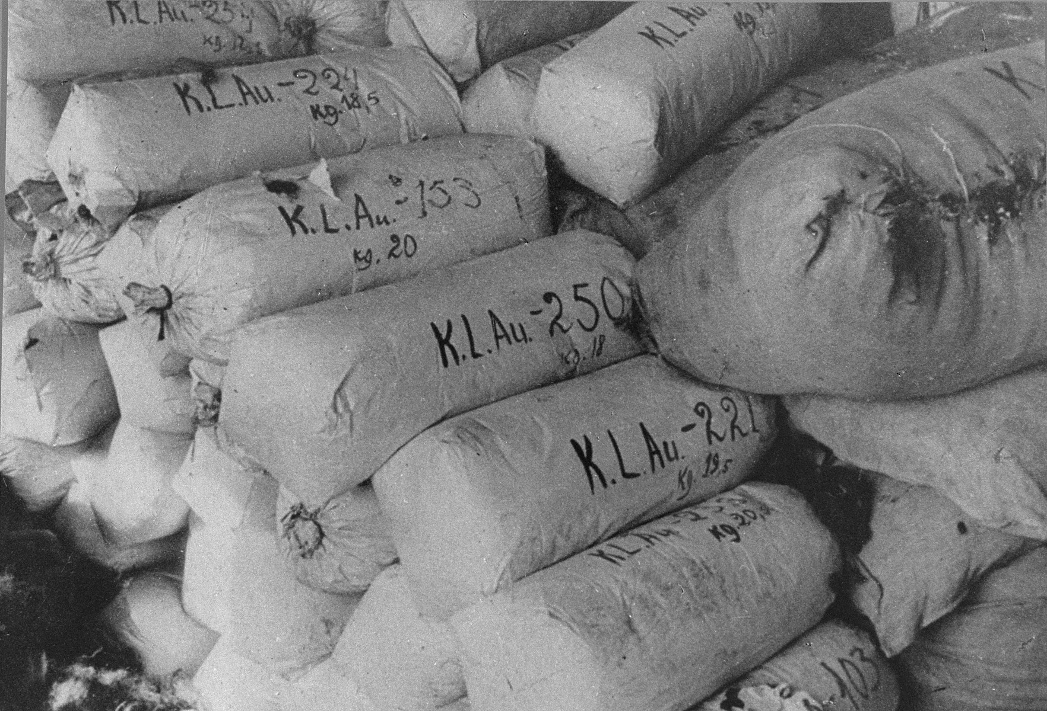

Slide 9
German car firm 'used hair from Auschwitz'
Rolls of textiles made by Schaeffler 'contain hair from 40,000 death camp inmates' Tony Paterson Tuesday 3 March 2009
“Germany's Nazi past continues to unsettle its present.”
“...history is catching up with German car parts supplier Schaeffler. According to the Independent, “the giant but debt-crippled Schaeffler car parts supplier was accused of using hair shorn from at least 40,000 Auschwitz death camp prisoners to make textiles at its factories in Nazi-occupied Poland during the Second World War. The highly disturbing allegations were contained in new evidence unearthed by Polish historians at the Auschwitz museum, who said they had found rolls of fabric made from camp historian has dismissed the allegations”.inmates’ hair at a former Schaeffler factory in Poland’s southern region of Silesia.”

Slide 10
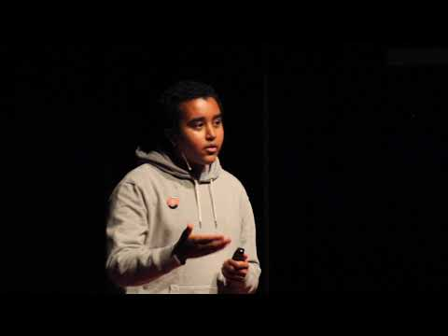

Slide 11
WHY KNOW THE STORY!
SYSTEMS
IMPACT
Nation/World
3 Branches of Government
Policies
How does the topic or issue of the story matter to the world?
Community
Transportation
Housing
Parks and Environment
Business and Commerce
Healthcare
Education
Arts and Culture
Public Safety and Defense
How does that topic or issue impact your community?
Me
Identity and stereotypes
Individuality and group loyalty
Conformity and deviance
Rights and responsibilities
How do I experience the topic or issue?

Slide 12
Community Issues
What is the issue impacting your community?
Focus Issue
What aspect of the community issue will you focus on?
Root Cause
What is the cause of the problem?
Which decision-makers or influencer are the focus of your campaign?
What are you asking for?
Targets
How do you plan to achieve your goals?
Goals
Tactics
12

